Slide 1





Career Development Training Course
Educational Opportunities
Apprenticeship
Voluntary Education
Credentialing
DANTES
Learning and
Development Roadmap

Slide 2
Enabling Objectives
STATE the purpose of the United Services Military Apprenticeship Program (USMAP)
IDENTIFY the Navy College Program
DISCUSS Tuition Assistance (TA) and NCPACE eligibility requirements
DISCUSS the GI Bill Program
IDENTIFY the United States Navy Community College (USNCC) and its purpose
STATE the purpose of Navy Credentialing Opportunities Online (Navy COOL)
STATE the purpose of Defense Activity for Non-Traditional Education Support (DANTES)
STATE the purpose of the Learning and Development Roadmap (LaDr)
Notes:
FACILITATOR GUIDE:
Review objectives.

Slide 3
References
Navy Military Personnel Manual, NAVPERS 15560 (Series)
Navy College Program at https://www.navycollege.navy.mil/
Navy Cool website at https://www.cool.osd.mil/usn/index.html
DANTES website at https://www.dantes.mil/
USMAP website at https://usmap.osd.mil/
MyNavyHR website at https://www.mynavyhr.navy.mil/
Veterans Affairs website at https://www.va.gov/education/about-gi-bill-benefits/post-9-11/
United States Navy Community College (USNCC) at https://www.usncc.edu/
Notes:
FACILITATOR GUIDE:
Review references.

Slide 4

Apprenticeship
United Services Military Apprenticeship Program (USMAP)
Is a formal military training program that provides Service members the opportunity to improve their job skills and to complete their civilian apprenticeship requirements while serving their country. USMAP has two components:
              The First part is formal classroom instruction hours.
              Instruction may be classroom, technical schools, or other approved means. These hours range from 144 to 432. This requirement cannot be waived.
        The Second part is On the Job training (OJT).
          Training at the place of work while doing the actual job. The OJT requirement, total work hours of between 2,000 to 6,000 hours, must be completed and documented.
Notes:
FACILITATOR GUIDE:
Every Apprenticeship requires related formal instruction training necessary to provide apprentices with knowledge in technical subjects related to the Apprenticeship.
Additional Notes:
1. Services' Initial/accession technical or advanced schools normally satisfy the requirement of formal classroom instruction hours.
2. OJT encompasses the skills and work experiences learned while doing the actual job. The amount of OJT hours required to complete the apprenticeship is trade related and will differ from trade to trade.
3. Experienced members may enroll in a Competency Based Apprenticeship which requires mastery of Competencies instead of documenting OJT hours.
4. Additional information for the USMAP program can be retrieved from the USMAP website.

Slide 5
Apprenticeship
A registered apprenticeship is a formal training program which combines on-the-job training (OJT) and related technical instruction. Completion of the program can help qualify members for employment in a recognized civilian occupation upon fulfillment of military service.
USMAP benefits:
Participants receive a nationally recognized “Certificate of Completion” from the U.S. Department of the Labor (DOL)
Enhances your military job skills
Demonstrates your motivation for more challenging military assignments
It requires no off-duty hours
Gives you a competitive advantage in obtaining civilian jobs
Notes:
FACILITATOR GUIDE:
Benefits cont...:
1. Apprenticeships build self-esteem and make you more marketable for future employment.
2. Civilian employers recognize the value of apprenticeships and on-the-job experience which often translates into increased pay.
3. Also, you log the hours while doing the job at your command.

Slide 6

United States Navy Community College (USNCC)
The USNCC provides naval-relevant associate degrees and certificates to enlisted Service member in the Navy, Marine Corps, & Coast Guard
  Mission
  The U.S. Naval Community College will advance warfighting advantage and enhance operational readiness by providing world class, naval-relevant education to a globally deployed force.
Notes:
FACILITATOR GUIDE:
Visit the USNCC website for verify current information at https://www.usncc.edu/ prior to facilitating the lesson.

Slide 7

USNCC Benefits
SERVICE
SERVICE MEMBER
Naval-relevant, college education to support operational needs, resulting in readiness and effectiveness
Curriculum fosters intellectual Skills development (analytical inquiry, information literacy, etc.) needed to be the most intellectually capable maritime force in the world
Direct education pathways for timely progress to certificates and degrees helps with retention
Investment in education provides earlier opportunity to develop the habits for continuous learning and professional leadership
Fully Funded certificate and associate degree programs
Direct education pathway with
select military friendly schools
Naval-relevant education that matches up to private-sector demands
Online/flexible
Does NOT deduct from TA benefits
Stackable certificates and transferable courses
Comprehensive student support
Notes:
FACILITATORS GUIDE:
Discuss how USNCC benefits the service and service member
Examples of Schools partnered with USNCC are:
Arizona State University (ASU)
Western Governors University
Alexandria Technical & Community College
Embry-Riddle Aeronautical University
University of Maryland Global Campus
3. All Sailors regardless of degree level can enroll in the Naval Studies certificate program
4. Current Associate degree programs
Cybersecurity
Aviation Maintenance
Logistics (Maritime Focus)
Organizational Leadership
Military Studies
Nuclear Engineering Technology
More programs are being added. Refer to the USNCC for information on additional degree programs

Slide 8
Knowledge Check
Which program offers a Department of Labor Certificate of Completion? What does it certify?
What are some of the benefits of the USMAP program?
What are the two components of USMAP?
Name two Sailor benefits of USNCC.
Does USNCC utilize Navy Tuition Assistance?
Notes:
ANSWERS:
USMAP; certifies you have completed an approved DOL apprenticeship program
Answers may vary. Enhances your military job skills, requires no off-duty hours, participants will receive a completion certificate from the DOL, competitive advantage with civilian jobs and possible increased pay
Possible answers: Formal training, OJT, and registered apprenticeship
Answers may vary (refer to slide for review)
No

Slide 9

Navy College Program
$
VOLED
              The Navy’s Voluntary Education program (VOLED) encompasses Tuition Assistance (TA) and the Navy College Program for Afloat College Education (NCPACE) which funds off-duty voluntary education.
NCPACE
              Navy College Program for Afloat College Education (NCPACE) provides personnel assigned to Type 2 and 4 (sea duty) commands access to education opportunities.
Fleet Engagement
              Navy College Fleet Engagement Teams in CONUS to serve as the education advisor to Navy Installation Commanding Officers and Officers-in-Charge of Navy Activities and Units.
NCVEC
              Navy College Virtual Education Center (NCVEC) staffed by Navy College education counselors who provide information and education counseling services.
Notes:
FACILITATOR GUIDE:
The Navy College Program is 100% virtual and consist of the four primary areas VOLED, NCPACE, NCVEC, and Fleet Engagement.

Slide 10

What is Tuition Assistance (TA)/NCPACE?
Tuition Assistance (TA) and the Navy College Program for Afloat College Education (NCPACE) are the Navy's primary financial assistance programs for voluntary education.
Both TA and NCPACE may be used for the following programs granted by schools who have signed a Department of Defense Memorandum of Understanding (DOD MOU):
  Associate degree
  Bachelor's degree
  Master's degree
  Certificate programs, certification preparation program or
  Diploma program approved by the Department of Veterans Affairs
Notes:
FACILITATOR GUIDE:
Additional Notes:
1. TA provides funding to eligible active-duty Sailors for tuition costs of courses taken in an off-duty status at a college, university, or vocational/technical institution, whose regional or national accreditation is recognized by the U.S. Department of Education.
2. Navy TA pays for independent study/distance learning courses taken via the NCPACE program.
· NOTE: There are no longer any instructor-led courses for the NCPACE program. It is 100% distance-learning.

Slide 11
TA/NCPACE Funding Caps
Payment for tuition will not exceed the following caps:
  $250.00 per semester hour
  $166.67 per quarter hour
  $16.67 per clock hour (for approved certificate/diploma programs only)
  TA and NCPACE will be limited to a fiscal year cap of 18 semester hours, 27 quarter hours, or 270 clock hours (or combination). The fiscal year cap applies to both TA and NCPACE combined.
  TA and NCPACE is limited to a lifetime cap of 120 semester hours, 180 quarter hours, 1800 clock hours (or combination). The lifetime credit cap applies to both TA and NCPACE combined.
  NOTE: Ensure to follow your local command TA instruction (if applicable) & always refer to current NAVADMIN for recent changes in policy.
Notes:
FACILITATOR GUIDE:
Always refer to the most recent NAVADMIN when briefing this slide and update as necessary.
Note the Following:
Tuition Assistance requests can be submitted as early as 120 days and must be command approved a minimum of 7 days preceding the course term start date.
2. Sailors may be enrolled in up to a maximum of two concurrent courses. Required laboratory courses with unique course identification numbers are exempt from this limit. The two course limit in line with fiscal quarter. See NAVADMIN 112/23

Slide 12

TA/NCPACE Eligibility
Active component and Training and Administration of Reserve (TAR) enlisted Sailors with less than 16 years of service must have at least 6 months remaining to their End of Active Obligated Service (EAOS) or Soft End of Active obligated Service (SEAOS) from the official term start date.
Must have been on board at least one year at first permanent duty station (NAVADMIN 190/14).
Must have served in the Navy for a minimum of three years and is not waiverable. (NAVADMIN 214/21).
NCPACE is only for Sailors assigned to Type 2 and Type 4 UICs.
Attend a school accredited by a regional or national accrediting agency recognized by the U.S. Department of Education.
Pass most recent physical fitness assessment or have been medically waived.
Recommended for promotion with no trait marks below 3.0.
Notes:
FACILITATOR GUIDE:
These are some of the requirements. Always refer to the most recent NAVADMIN when briefing this slide and update as necessary.
Additional Notes:
Inform the class to refer to the current NAVADMIN for requirements for TA/NCPACE. The requirements listed are some but not all of the required eligibility requirements for TA/NCPACE.
Additional requirements:
1. Officers with a minimum of 8 years of prior enlisted Active Duty service (Army, Navy, Marine, Air Force, Coast Guard) including
limited duty officers (LDO) and chief warrant officers (CWO) are eligible to use TA or NCPACE at all officer ranks. All other officers become eligible upon promotion to O3.
2. Recommend before enrolling in school to receive education counseling from a Navy College Virtual Education Center Counselor to verify eligibility and submission deadlines.

Slide 13
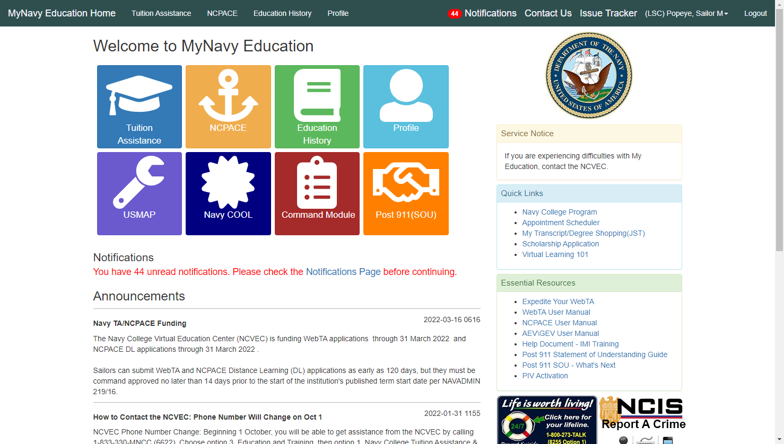
MyNavy Education
Use MyNavy Education to submit TA/NCPACE applications, print authorized vouchers, view education history and upload degree plans.
Notes:
FACILITATOR GUIDE:
1. Use this slide to show what the MyNavy Education homepage looks like.
2. Ensure to make note this is where Sailors go to submit their TA applications, sign the Statement of Understanding for Post/911, etc.

Slide 14
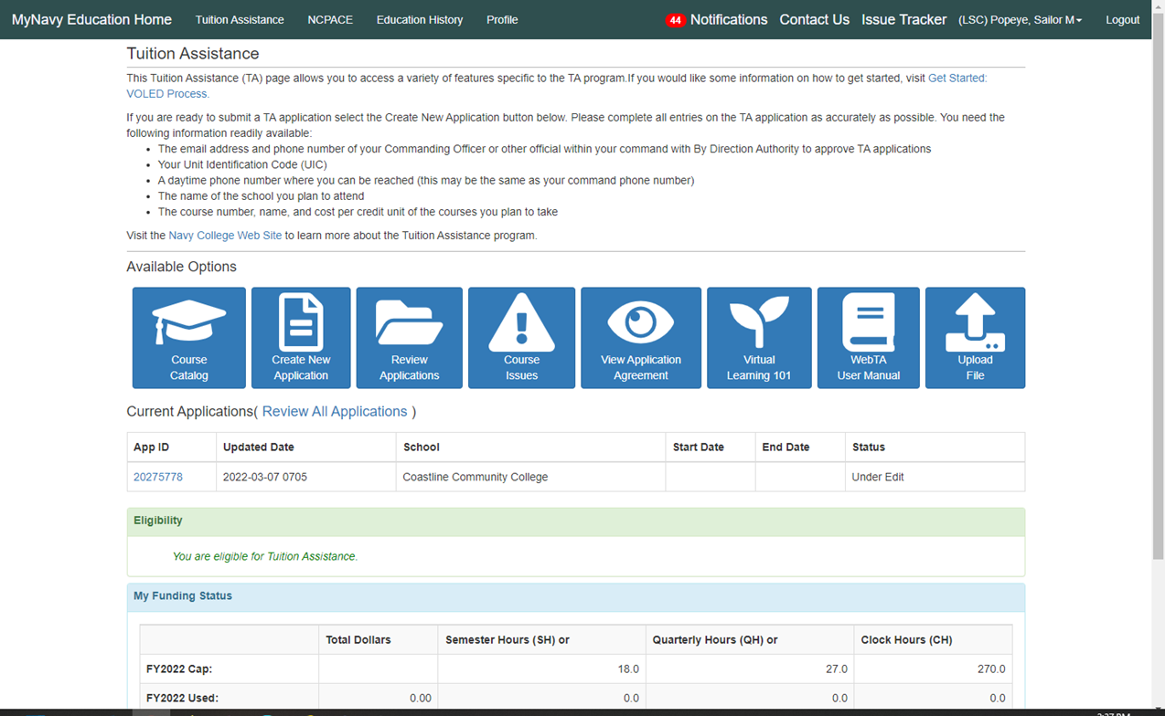
MyNavy Education
Notes:
FACILITATOR GUIDE:
Use this slide to point out how Sailors can track their TA eligibility, usage, complete the Virtual Learning 101 course, upload files, submit and review TA applications.

Slide 15
Other Voluntary Education Programs
Advanced Education Voucher (AEV) - Enlisted
  https://www.navycollege.navy.mil/common-resources/education-voucher-programs.htm
Graduate Education Voucher (GEV) - Officer
  https://www.navycollege.navy.mil/common-resources/education-voucher-programs.htm?section=sr-gev
Graduate Certificate Programs
  https://nps.edu/web/ddm/graduate-certificate-programs
Olmsted Foundation Scholar Program
  https://olmstedfoundation.org/
Notes:
FACILITATOR GUIDE:
Slide is for informational purposes. Refer to Navy College website for more information or you may choose to research ahead of time and provide a short brief on each.
Additional Notes:
AEV: The Advance Education Voucher Program (AEV) enables selected senior enlisted personnel (E-7 to E-9) to obtain a Navy-relevant bachelor’s or master’s degree in designated areas of study through off-duty education at any U.S. Department of Education (DOE) accredited institution. The AEV program provides 100% funding for tuition, books, and related approved fees within guidelines and funding limits.
2. GEV: The Graduate Education Voucher program (GEV) was established to provide increased opportunity and incentive for selected Unrestricted Line (URL) officers who wish to obtain a master’s degree during off-duty hours. The GEV Program enables selected officers, with demonstrated superior performance and potential for future contributions to the Navy, to earn a Navy-relevant master’s degree leading to an approved subspecialty while meeting other Navy needs.
3. Graduate Certificate Programs offered at Navy Post Graduate School (NPS): The Department of Defense Management (DDM) offers a unique selection of specialized, high-quality, tailored graduate certificates focused on defense management. These certificate options are:
Offered to resident and distance learning students
Composed of a series of four to five courses
Taught by the highly qualified DDM faculty
4. Olmsted Foundation Scholar Program: The Olmsted Foundation Scholar Program provides select active duty officers serving in operational career fields with funding for two years of graduate study using a foreign language while providing overseas cultural and travel opportunities.

Slide 16
Navy College Resources
Navy College Program
For more information about TA/NCPACE funding caps, please visit the NCP website at: https://www.navycollege.navy.mil
Navy College Virtual Education Center
The NCVEC can be reached Monday through Friday from 0700-1900 EST.
Call 833-330-MNCC (6622).
Select option 3 “Education and Training”, then option 1 “Navy College, Tuition Assistance and Counseling.”
Notes:
FACILITATOR GUIDE:
Review contact information.

Slide 17
Montgomery GI Bill Active Duty (MGIB-AD)
MGIB-AD can help pay for education and training programs. If you have served at least 3 years on active duty.
You may qualify for eligibility for education benefits through this program if you were honorably discharged and meet the following requirements:
  Entered active duty after June 30, 1985
  Have a H.S. diploma, GED or 12 college credit hours
  Contributes $100 per month for the first 12 months of active duty
  Served continuously for 2 or more years if that was your agreement when you enlisted
  Sailors usually have 10 years to use benefits. This may change depending on situation
  MGIB-AD provides a monthly educational assistance allowance for attending college (current rates can be found on the Veterans Affairs website).
Notes:
FACILITATIOR GUIDE:
Visit the link below for the most up-to-date information regarding MGIB-AD prior to briefing the slide.
https://www.va.gov/education/about-gi-bill-benefits/montgomery-active-duty/

Slide 18
Post-9/11 GI Bill (Chapter 33)
For Sailors who served at least 90 days on active duty since September 11, 2001.
Can receive up to 36 months of benefits, including:
  Tuition and fees (will cover the full cost of public, in-state tuition and fees for Sailors qualified for maximum benefit)
  E-5 BAH with dependents based on zip code of school (if attending more than half time)
  Up to $1,000 for books and supplies per school year
  If military service ended after January 1, 2013 benefits will never expire
  Note: If you served fewer than 36 months, your percentage of benefits ranges from 40 to 90 percent.
Notes:
FACILITATIOR GUIDE:
1. Visit the link below for the most up-to-date information regarding Post 9/11 prior to briefing the slide.
https://www.va.gov/education/about-gi-bill-benefits/post-9-11/
2. The VA has oversight of this program. Questions that are not covered here should be referred to the VA.
VA contact number is: 800-698-2411
3. Be advised there are other eligibility requirements and the Service member is only required to meet one of them. Full list of requirements are:
You may be eligible for education benefits if you meet at least 1 of these requirements.
You served at least 90 days on active duty (either all at once or with breaks in service) on or after September 11, 2001, or
You received a Purple Heart on or after September 11, 2001, and were honorably discharged after any amount of service, or
You served for at least 30 continuous days (all at once, without a break in service) on or after September 11, 2001, and were honorably discharged with a service-connected disability, or
You’re a dependent child using benefits transferred by a qualifying Veteran or service member
4. Monthly housing allowance is paid to the student, verification of enrollment is required in order to receive it. Book stipends are also paid to the student.
5. Approved training includes:
• Graduate and undergraduate degrees
• Vocational or technical training
• On-the-job training and apprenticeship
• Flight training
• Correspondence training
• Licensing and national testing programs
• Entrepreneurship training and tutorial assistance

Slide 19
POST 9/11 TABLE
Less than 36 months rates:
  90 percent: 30 total months
  80 percent: 24 total months
  70 percent: 18 total months
  60 percent: 12 total months
  50 percent: six total months
  40 percent: 90 or more days, excluding active duty in entry level and skill training
  Note: Total months, include active duty in entry level and skill training.
Notes:
FACILITATOR GUIDE:
Review table with class.

Slide 20
Transfer of Education Benefits
Sailors on active duty or in the Selected Reserve who meet all of the following requirements may be eligible to transfer benefits:
  Completed at least 6 years of service on the date request is approved, and
  Agree to add 4 more years of service, and
  The person receiving benefits is enrolled in the Defense Enrollment Eligibility Reporting System (DEERS).
While on active duty, requests to Transfer of Educational Benefits (TEB) are initiated through MyNavy Education by signing the Statement of Understanding. Followed by allocating benefits to dependents via MILCONNECT.
Notes:
FACILITATIOR GUIDE:
1. Visit the link below for the most up-to-date information regarding transferability prior to briefing the slide.
https://www.va.gov/education/transfer-post-9-11-gi-bill-benefits/
2. Dependents may be able to get money to pay for these expenses:
Tuition
Housing
Books and supplies
Fees for national standardized tests
Fees for licensing and certifications

Slide 21
Transfer of Education Benefits (cont’d)
If the DoD approves TEB, the family members may apply for benefits.
Sailors who separate from active duty who transferred their education benefits, can still provide a future effective date for when the TEB can be used, change the number of months transferred, or revoke the TEB by submitting a written request to VA through MILCONNECT.
Notes:
FACILITATIOR GUIDE:
Visit the link below for the most up-to-date information regarding transferability prior to briefing the slide.
https://www.va.gov/education/transfer-post-9-11-gi-bill-benefits/

Slide 22
Yellow Ribbon Program (YRP)
Program allows institutions of higher learning to voluntarily enter into an agreement with the VA to fund tuition and fee expenses that exceed the tuition and fee amounts payable under the Post-9/11 GI Bill.
To be eligible for the program you must be:
  Enrolled in an approved program offered by an institution of higher learning participating in the Yellow Ribbon Program
  Served at least 36 months after Sept 10, 2001, and were honorably discharged
  Discharged with a service-connected disability and served 30 continuous days after Sept 10, 2001
  Dependent who received benefits from an eligible service member
  Active duty may use the Yellow Ribbon Program effect August 1, 2022.
Notes:
FACILITATIOR GUIDE:
Visit the link below for the most up-to-date information regarding the yellow ribbon program prior to briefing the slide.
https://www.va.gov/education/about-gi-bill-benefits/post-9-11/yellow-ribbon-program/
Additional Notes:
*New provision per the Harry W. Colmery Veterans Educational Assistance Act (Forever GI Bill) allows active duty to use the Yellow Ribbon Program.

Slide 23
Knowledge Check
What is the TA funding cap per fiscal year?
What is the lifetime credits allowed in a career?
Who can participate in the NCPACE program?
How long do Sailors have to use their Montgomery GI Bill after they separate from active duty? Post 9/11 GI Bill?
When are Sailors eligible to transfer their Post 9/11 GI Bill benefits to their spouse and children?
What is the Yellow Ribbon Program?
Notes:
ANSWERS:
TA and NCPACE will be limited to a fiscal year cap of 18 semester hours, 27 quarter hours, or 270 clock hours (or combination). The fiscal year cap applies to both TA and NCPACE combined
120 credit hours
Sailors assigned to Type 2 and Type 4 UICs
10 years
After serving 6 years active duty and reenlisting for at least 4 more years
Program allows institutions of higher learning to voluntarily enter into an agreement with the VA to fund tuition and fee expenses that exceed the tuition and fee amounts payable under the Post-9/11 GI Bill.

Slide 24

Navy Credentialing Program
The Navy Credentialing program enables Navy personnel to earn civilian certifications and licenses that correspond to their Service occupations, academic degree, off duty training, reserve occupation, and prior-service credentialing.
Benefits of Navy Cool are:
                Every Navy rating and designator has at least one professional credential associated.
                Certifications and licensing enhance your military career while creating future opportunities in the civilian employment sector.
                Credentialing translates to greater rating knowledge, skills, competency, and personal fulfillment.
                Industry-recognized credentials are often the key to a successful transition to civilian employment.
Notes:
FACILITATOR GUIDE:
Visit the Navy Cool website for the most up-to-date information prior to briefing the slide.
Additional Notes:
1. Navy Credentialing Opportunities On-Line (COOL) website that provides information on how Navy personnel can fulfill requirements for civilian credentials related to their ratings, designators, and jobs.
2. The Navy’s Credentialing Program Office funds exam vouchers for active and reserve Navy workforce.
3. MILGEARS powered by COOL helps Sailors through all phases of the career lifecycle to plan and achieve professional and personal goals by highlighting career possibilities and helping you visualize how to reach those goals.

Slide 25



Defense Activity for Non-Traditional Education Support (DANTES)​
Defense Activity for Non-Traditional Education Support (DANTES) offers on-line, self-paced, academic skills training to help military members gain the knowledge they need to complete education credentials and college degree programs; advance in their military careers; and successfully transition into the civilian workforce.
What is offered under DANTES:
                College Level Examination Program (CLEP)
                Online Academic Skills Course (OASC)
                DANTES Subject Standardized Test (DSST)
Notes:
FACILITATIOR GUIDE:
1. Discuss the importance of CLEP, OASC and DSST. Take this time to use your experience of discuss best practices when counseling Sailors.
2. CLEP:
The College Level Examination Program (CLEP) is a credit-by-examination program that measures a student's level of comprehension of introductory college-level material and consecutively earn college credit.
3. OASC:
Improve your academic skills, raise your standardized scores, and achieve college readiness with Peterson’s Online Academic Skills Course (OASC). Through partnership with DANTES, Peterson’s provides this academic service free of charge to all active duty military, Reserves and National Guard, their families, and DoD civilians.
4. DSST:
The nationally recognized DSST Credit-by-Exam Program gives students the opportunity to get college credit for learning acquired outside the traditional classroom.

Slide 26
Learning and Development Roadmap
BACKGROUND
COMMAND’S RESPONSIBILITY
LaDR offers Sailors and their leadership a guide that displays in one location all of their current and projected enlisted training and education requirements as they advance
Ensure all Sailors have access to their LaDR
Ensure Sailors appearing before a CDB have their LaDR reviewed
PURPOSE
SAILOR’S RESPOSIBILITY
Provides Sailors a checklist to see where they are, and where they need to head for personal and professional success
Use as a guide to career development
Verify that all items completed are updated
Notes:
FACILITATIOR GUIDE:
1. Discuss the importance of the LaDr to the class. Take this time to use your experience of discuss best practices when counseling Sailors.
2. Command responsibilities cont…
Provide information and counseling that encourages Sailors to make maximum use of all programs and opportunities in their LaDR to include CAVE programs
3. Purpose cont..
Provides leaders a tool for mentoring and Career Development Boards (CDB), as outlined in OPNAV Instruction 1500.77A
Provides leadership an in-depth understanding of all rating opportunities
4. Sailors Responsibilities cont..
Comply with all time sensitive items in the LaDR in order to hit gated windows for:
Reenlistment
Advancement
Orders
Training

Slide 27
Learning and Development Roadmap
Rating Career Path (Advancement)
Active Duty, SELRES and FTS
Professional Military Education
Required Navy PME
Required Community PME
Recommended Navy PME
Recommended Community PME
Reserve PME (courses with reserve points)
Skills Training (Great Sailor First)
Required Skills Training
Recommended Skills Training
NEC Opportunity and Critical NECs
Education
Rating Relevant Options
General Information
Degree Plans
Personal and Professional Growth
Career Development Board
Qualifications and Certifications (Navy COOL & USMAP)
Notes:
FACILITATOR GUIDE:
Identify the 5 sections of the LaDr
ADDITIONAL Notes:
Skills Training (Great Sailor First) cont…
Job Description
Recommended Billets
Personal and Professional Growth cont…
Stay Navy (Retention Tools)
Separation/Retirement/ Transition
Professional Military Education cont…
Navy Professional Reading Program
Recommended Community Reading
Reference Section

Slide 28
Enlisted Sailors’ Career Continuum
KEYSTONE
Fleet Seminar Joint Professional Military Education
E9
Navy Senior Leadership Seminar
CMC/COB
Advanced Education Voucher (AEV)
Development Opportunities
Sailor 360
Senior Enlisted Academy
E8
TA/NCPACE
Primary Enlisted PME
Mid-Career CONSEP
Chief Petty Officer Leader Development (CPOSLC)
E7
Basic Enlisted PME
Chief Petty Officer Initiation
Department of Labor Apprenticeship (USMAP)
Introductory Enlisted PME
Advanced Leader Development (E6)
E5-E6
First Term CONSEP
Intermediate Leader Development (E5)
Navy Credentialing “COOL”
Advanced Technical Training “C School”
DANTES College Testing (CLEP & DSST)
E4
Foundational Leader Development
Online Academic Skills Program-
Block Learning / Advanced Technical Training
Development Requirements
E1-E3
Professional Qualifications
DEP
Technical Training “A School”
RTC
Notes:
FACILITATIOR GUIDE:
Review Career Continuum chart. This is not all inclusive some steps on the development opportunities side can be completed sooner than later or vice versa.

Slide 29
Knowledge Check
What are some benefits of the Navy Credentialing?
What is the purpose of the LaDr?
Name the 5 sections of the LaDr? Provide an example of what you can find in each.
What are the eligibility requirements to transfer the Post 9/11 GI Bill?
Notes:
ANSWERS:
Benefits are:
Every Navy rating and designator has at least one professional credential associated.
Certifications and licensing enhance your military career while creating future opportunities in the civilian employment sector.
Credentialing translates to greater rating knowledge, skills, competency, and personal fulfillment.
Industry-recognized credentials are often the key to a successful transition to civilian employment.
Provides Sailors a checklist to see where they are, and where they need to head for personal and professional success 10 years
Provides leaders a tool for mentoring and Career Development Boards (CDB), as outlined in OPNAV Instruction 1500.77A
Provides leadership an in-depth understanding of all rating opportunities
Rating Career Path (Advancement), Skills Training (Great Sailor First), Personal and Professional Growth, Professional Military Education, Education. Note answers for examples will vary.
Completed at least 6 years of service on the date request is approved, and
Agree to add 4 more years of service, and
The person receiving benefits is enrolled in the Defense Enrollment Eligibility Reporting System (DEERS)

Slide 30
Summary and Review
In this lesson we discussed:
  United Services Military Apprenticeship Program (USMAP)
  Navy College Program
  Tuition Assistance (TA) and NCPACE eligibility requirements
  GI Bill Program
  United States Navy Community College (USNCC) and its purpose
  Navy Credentialing Opportunities Online (Navy COOL)
  Learning and Development Roadmap (LaDr)

Slide 31

Educational Opportunities

